Slide 1
Hotel Booking Management System

Slide 2
Project Objective
The main objective of this project is to develop Hotel Bookings Management System (HBMS).
This system can be used to search for Hotels and to book the rooms in that particular hotel.
We want to provide comfort to the user in order that he can place order from any place and at any time.

Slide 3
Project Module Flow Diagram
Hotel Management System
Visitor
Admin
Employee
User
Hotel List
Profile
Hotel Information
Profile
Room List
Hotel
Hotel List
Room
Room List
Register
Room List
Login
Employee
User Room Booking
Book Room
Exit
Payment
Exit
Booking Report
Exit

Slide 4
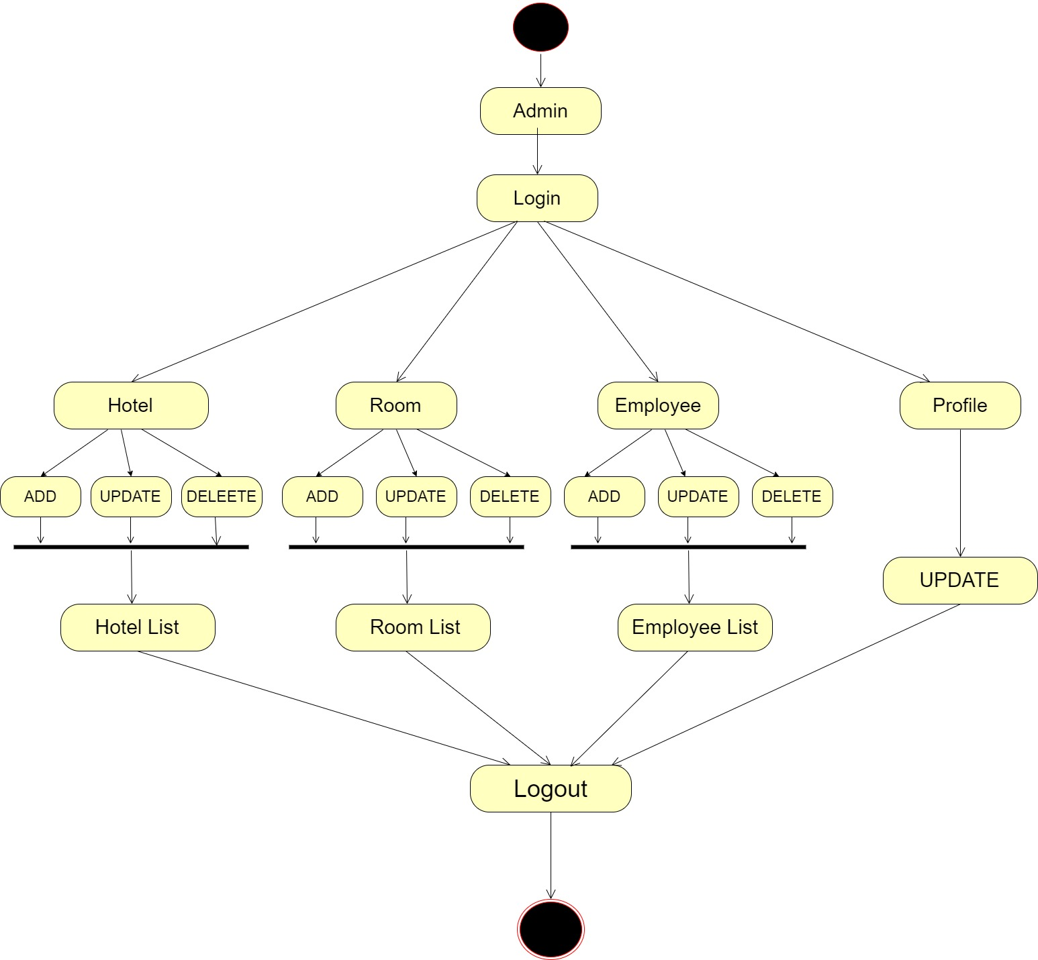
Activity Diagram for Admin

Slide 5
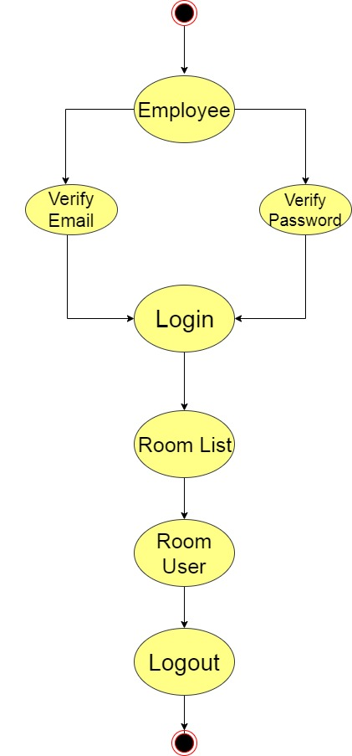
Activity Diagram for Employee

Slide 6
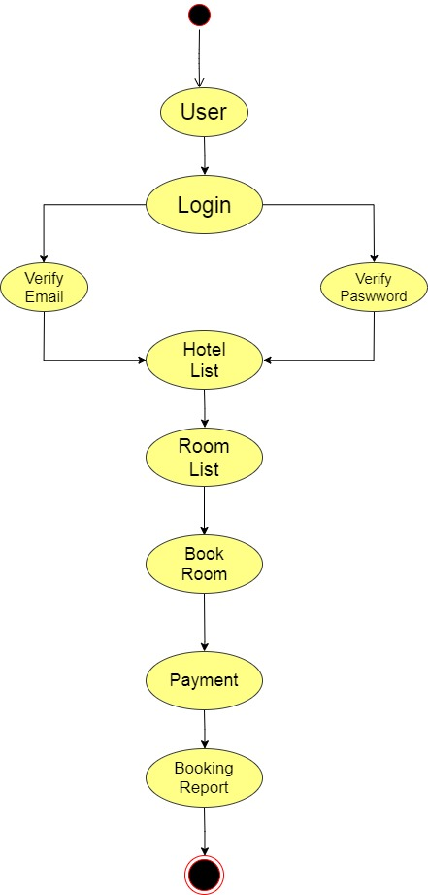
Activity Diagram for User

Slide 7
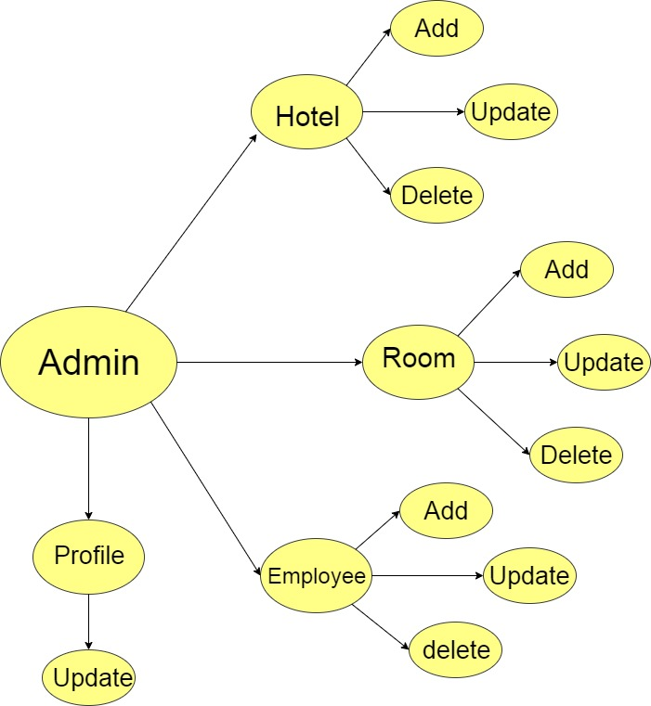
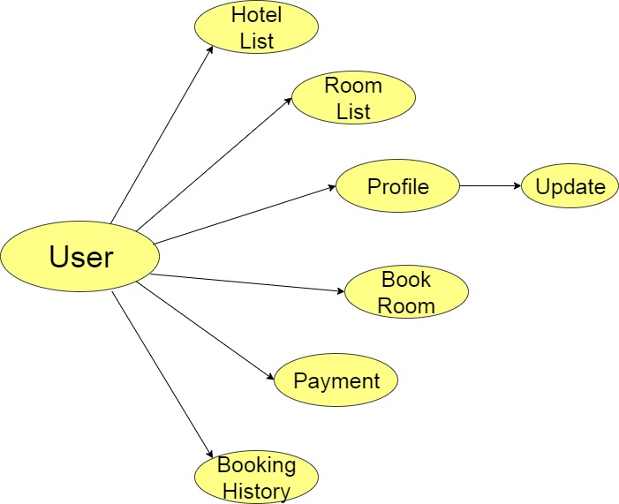
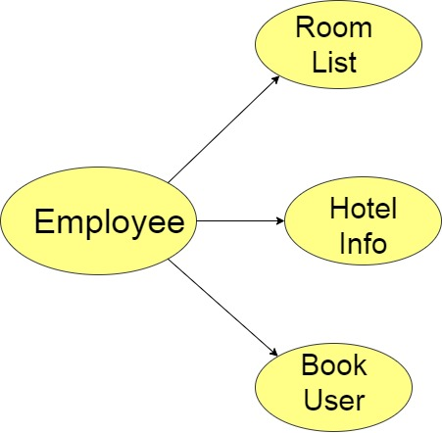
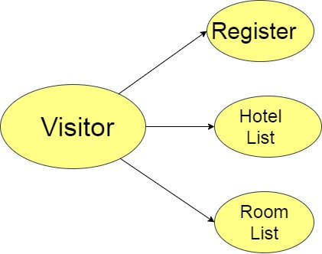
Use Case Diagram

Slide 8
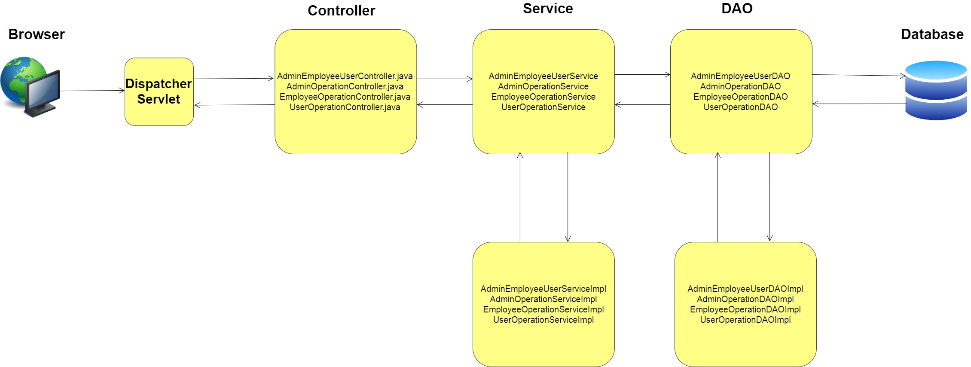
Project Architecture

Slide 9
Needed Technology Or Software
Spring Boot For Backend
Visual Studio Code for Angular Front end
My Sql Database

Slide 10
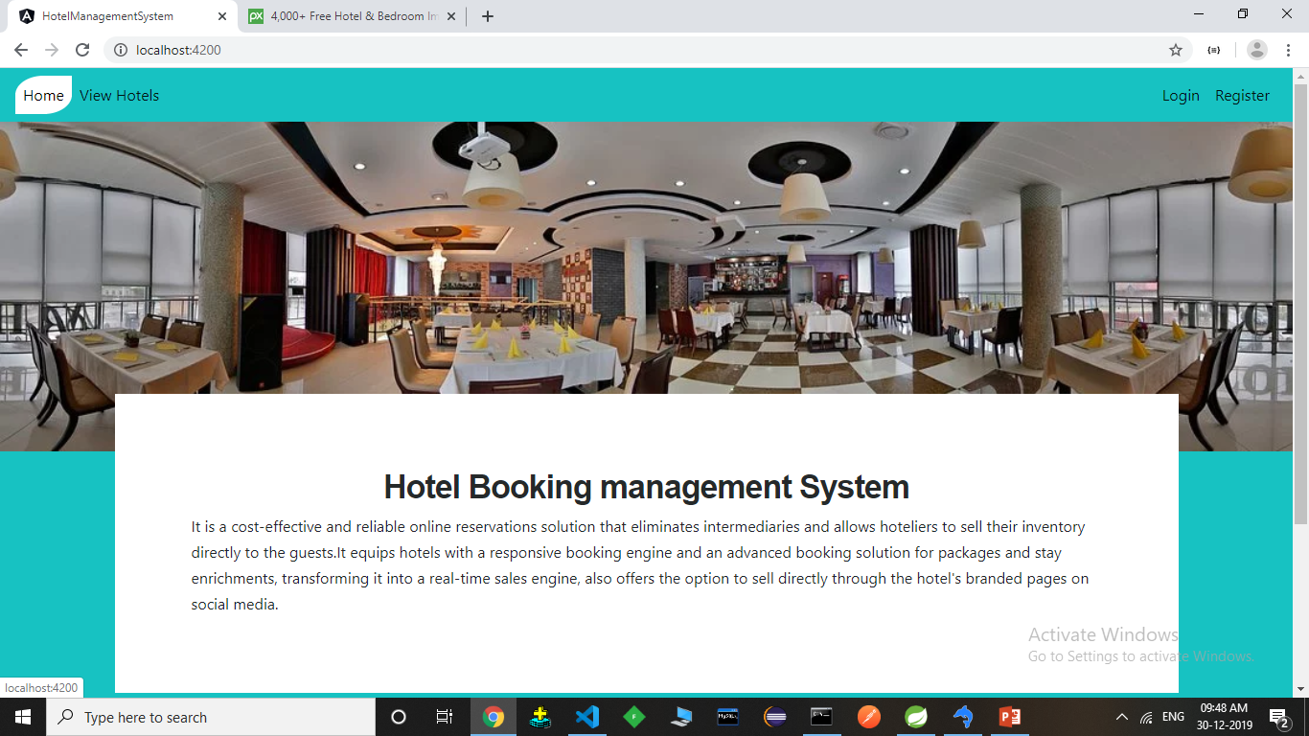
Home page

Slide 11
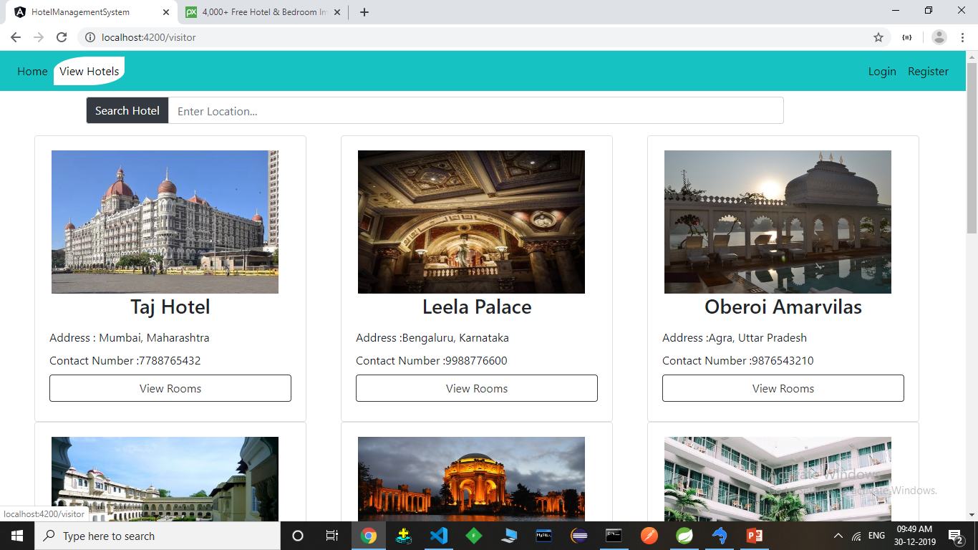
View Hotel

Slide 12
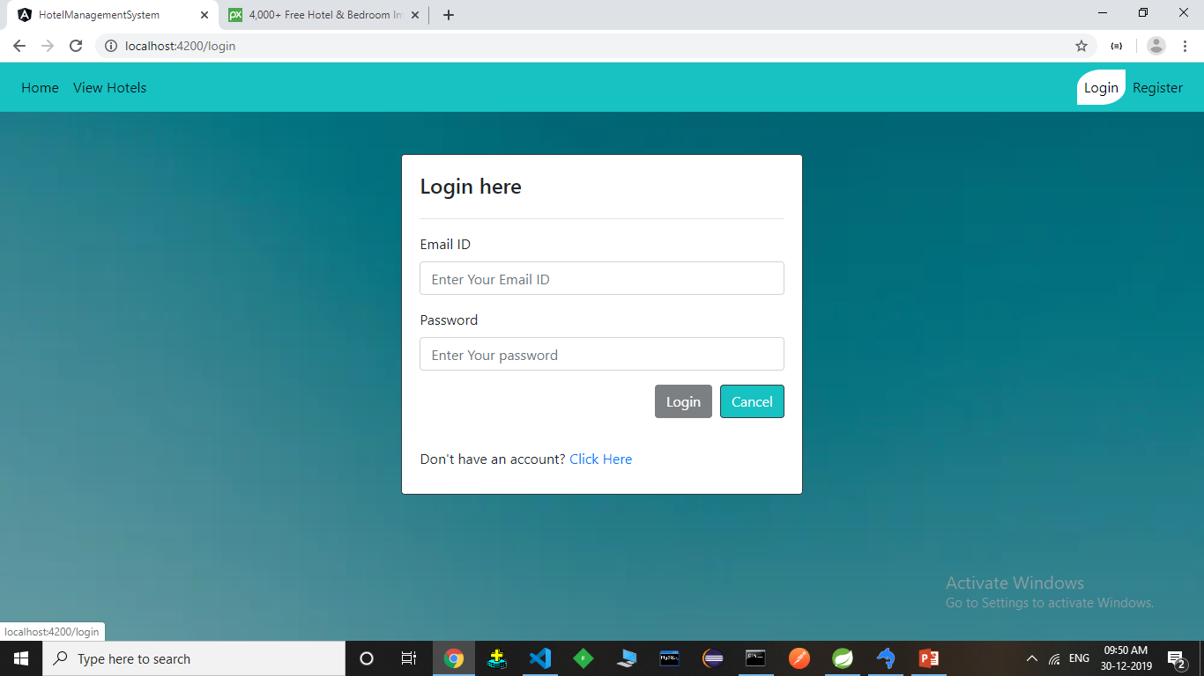
Login

Slide 13
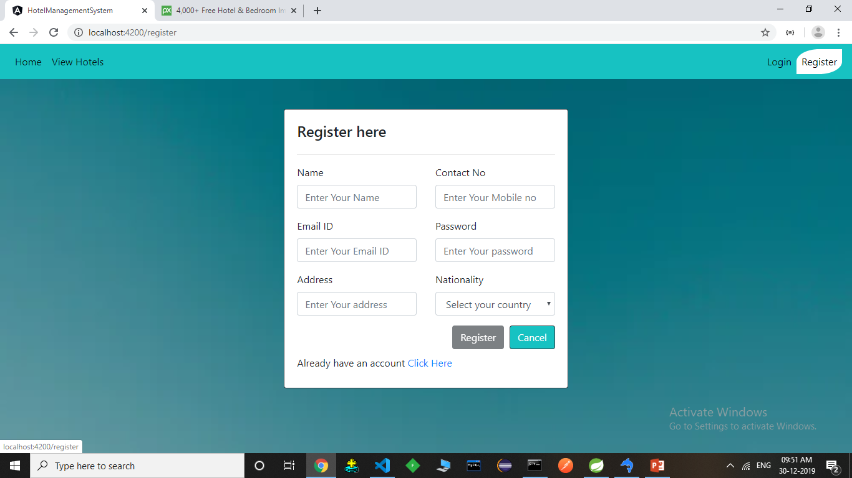
Register

Slide 14
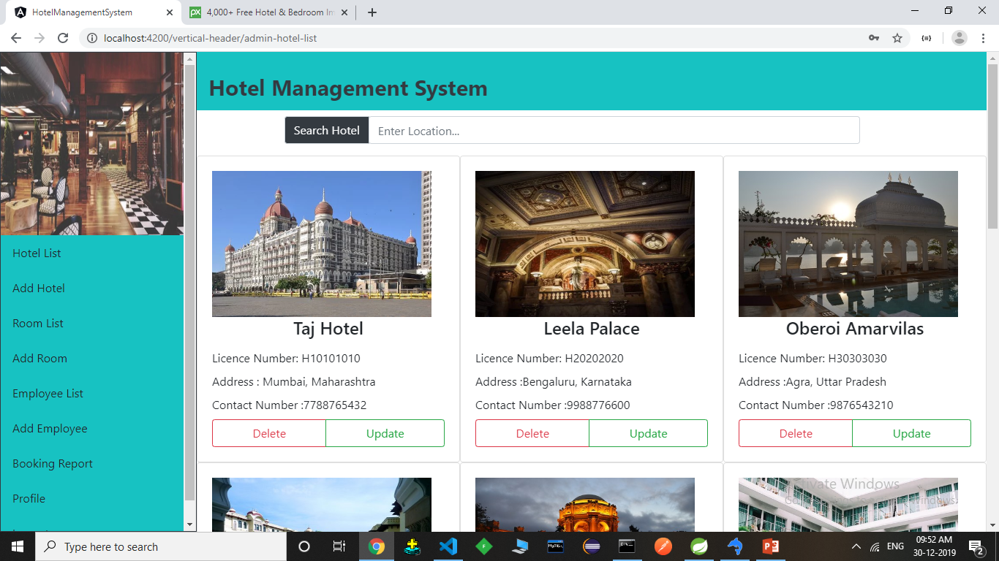
Admin Hotel List

Slide 15
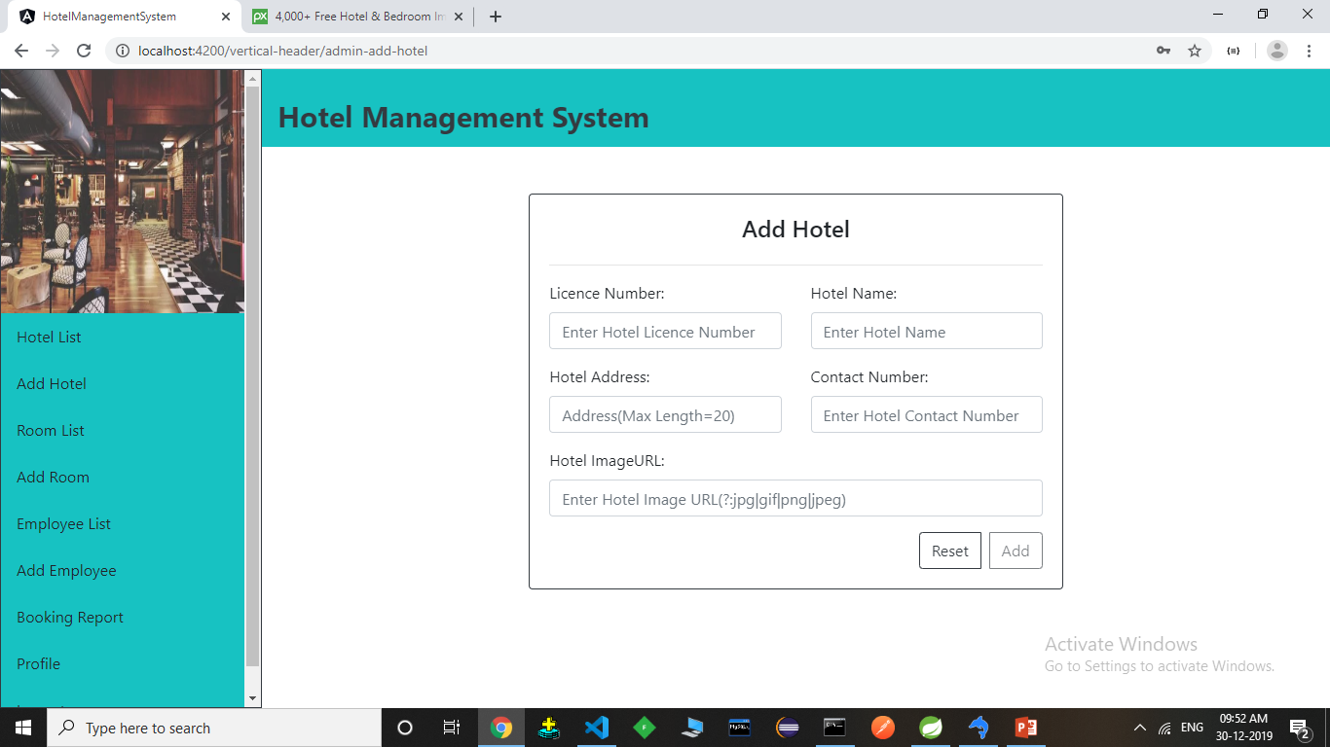
Admin Add Hotel

Slide 16
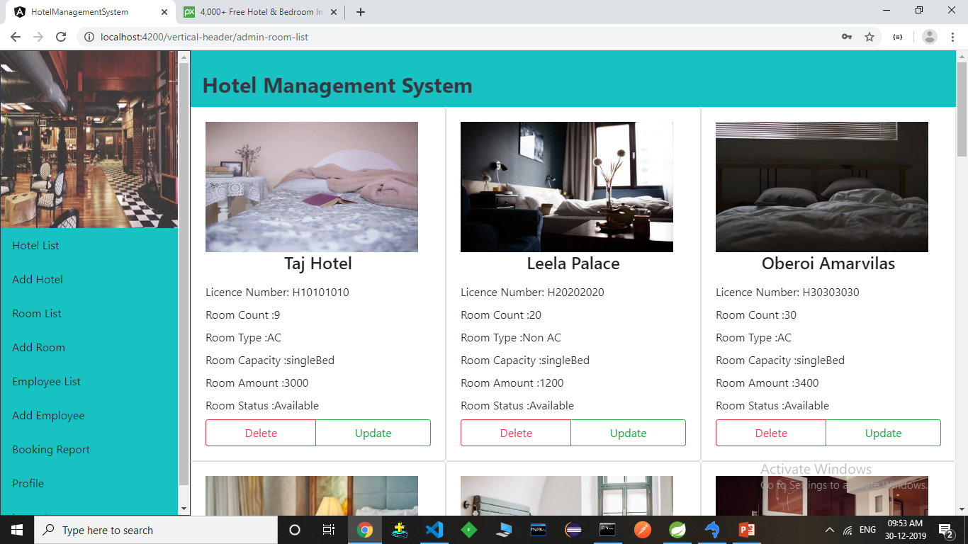
Admin Room List

Slide 17
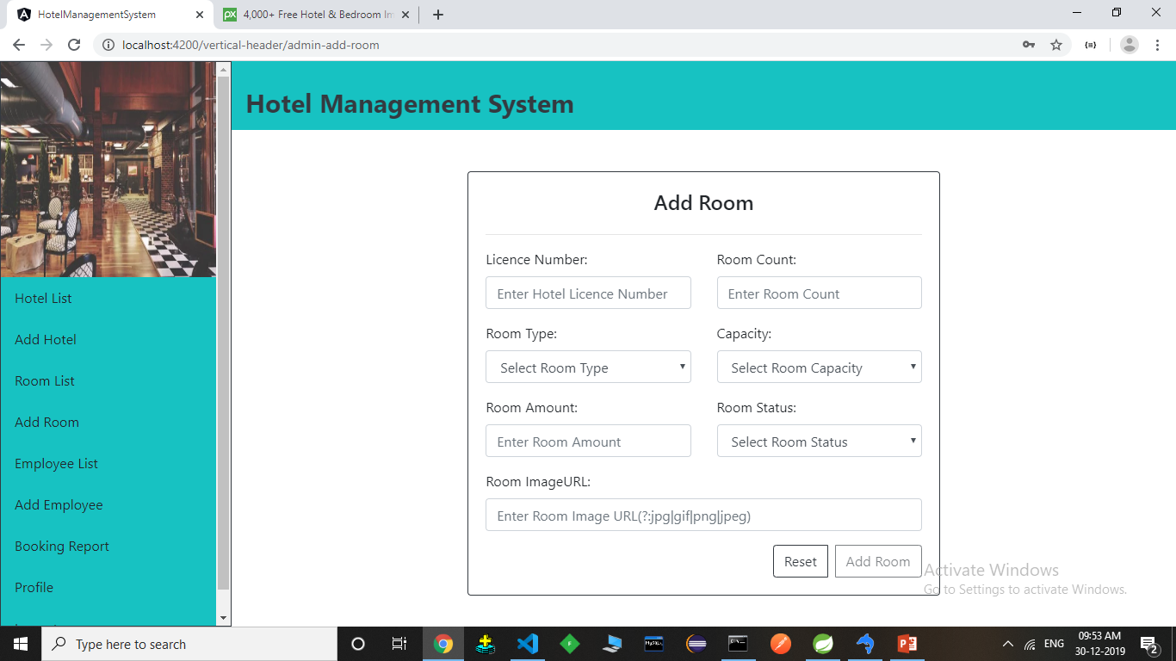
Admin Add Room

Slide 18
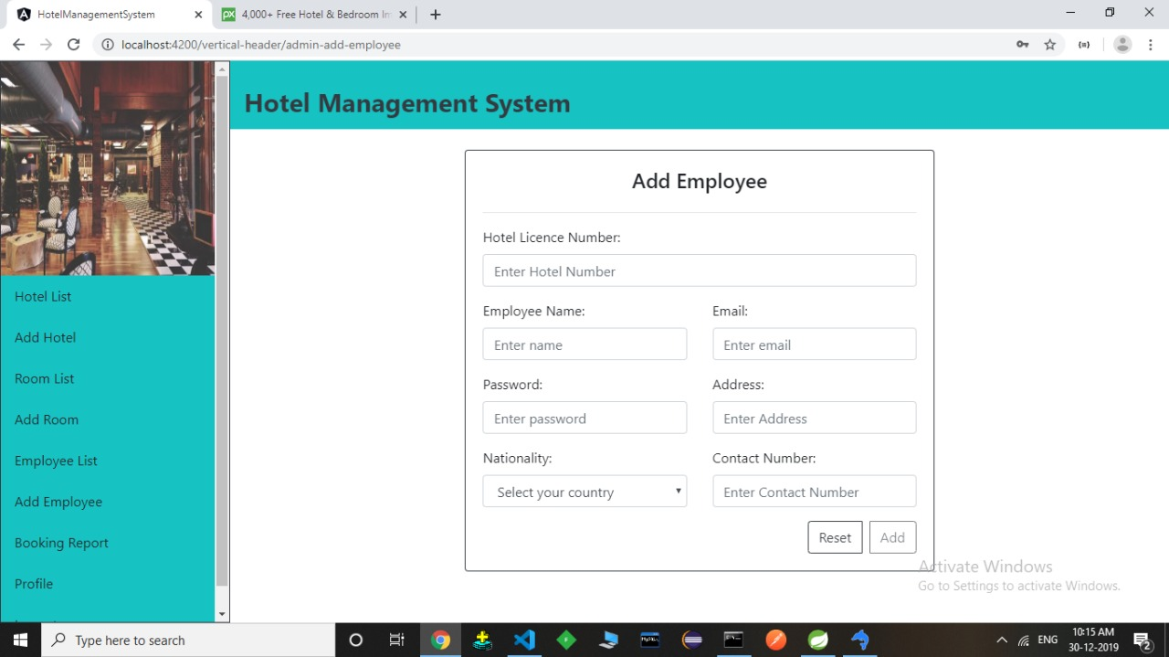
Admin Add Employee

Slide 19
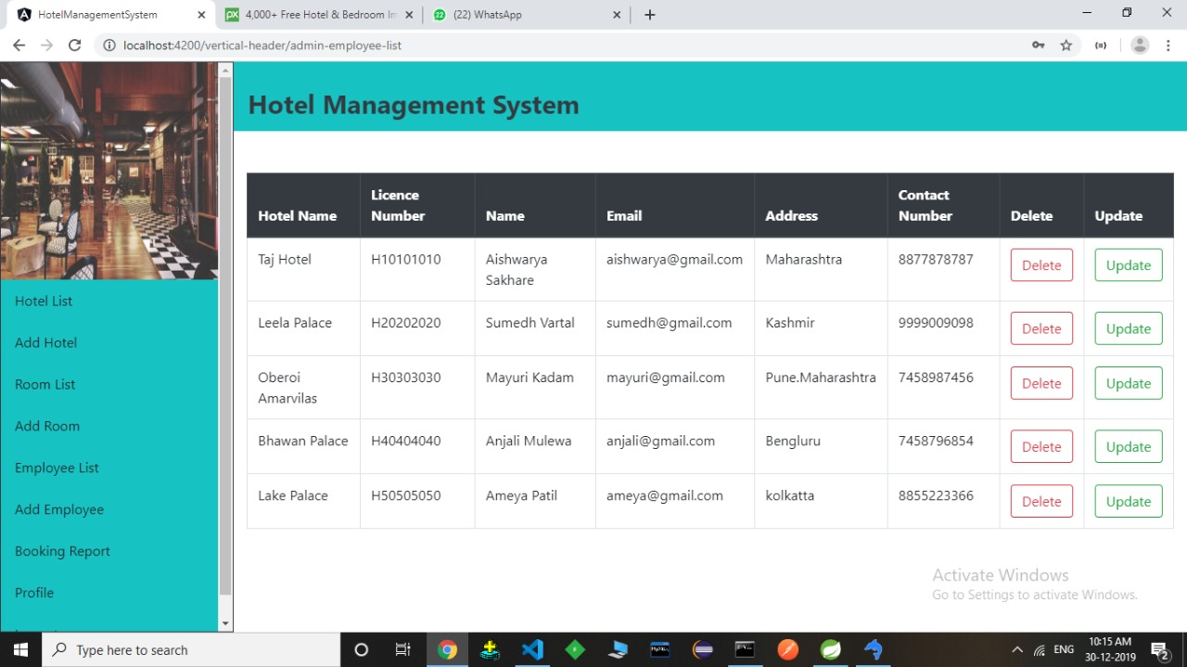
Admin Employee List

Slide 20

User Hotel List

Slide 21
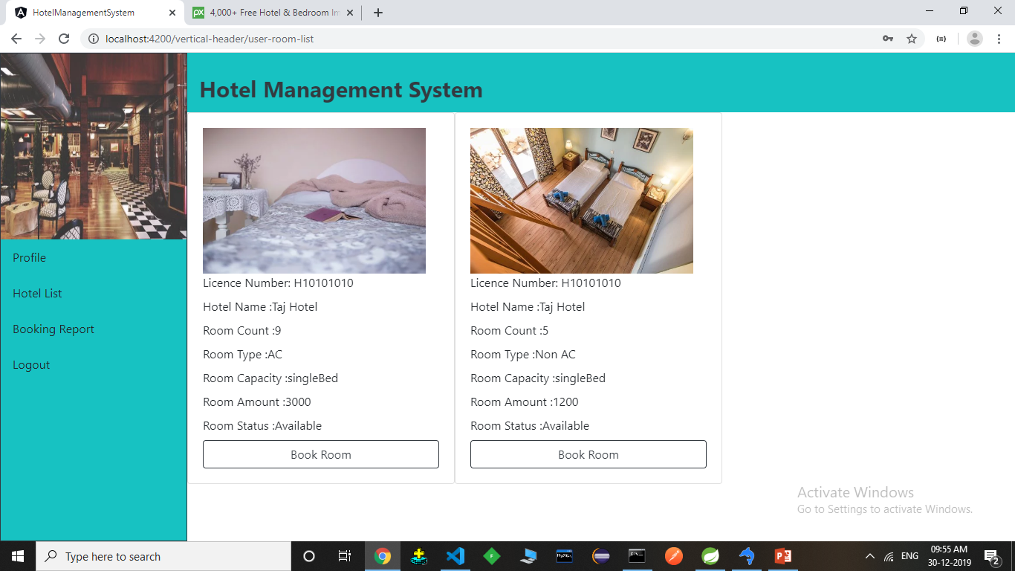
User Room List

Slide 22
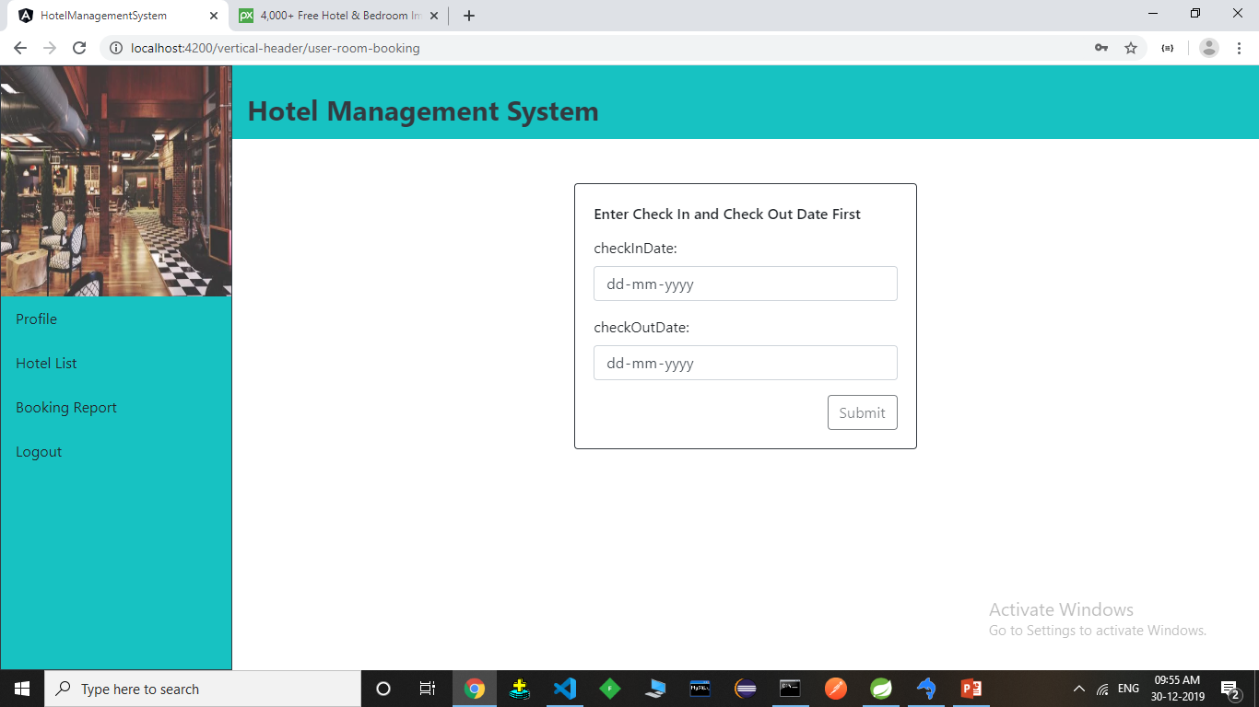
User Room Booking

Slide 23
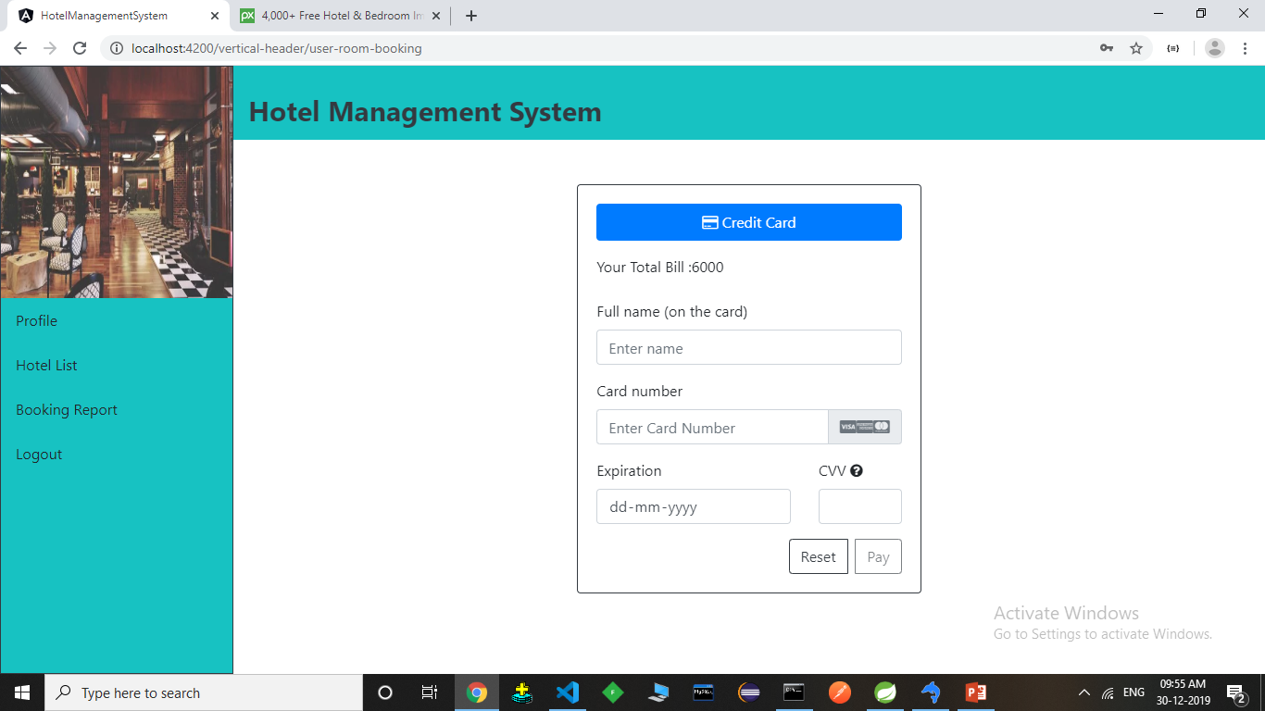
User Room List

Slide 24

Employee Room List

Slide 25

Employee Room Booking

Slide 26
Thank You

